Slide 1
Angular Routing
Lazy Loading
Lecture 10
By James(Jin) Wang
12/26/2021

Slide 2
Outline
Building and Serving our Files
Preparing for Lazy Loading
Lazy Loading
canLoad Guard
Preloading Feature Modules
Custom Loading Strategies

Slide 3
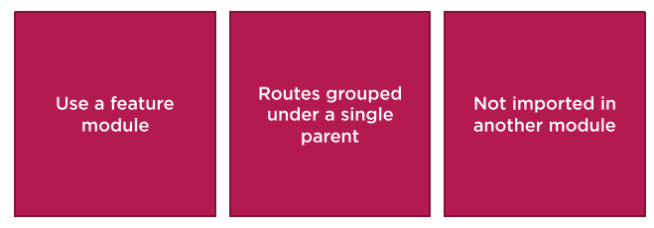
Lazy Loading
  Preparing for Lazy Loading

Slide 4
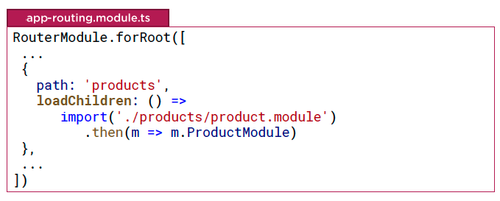
Lazy Loading
  Lazy Loading
  Demo: lazy loading

Slide 5

Lazy Loading
  Lazy Loading

Slide 6
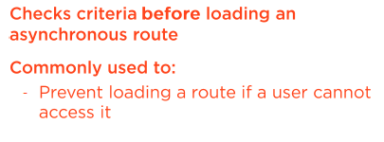
Lazy Loading
  canLoad Guard
  Demo: canLoad guard

Slide 7
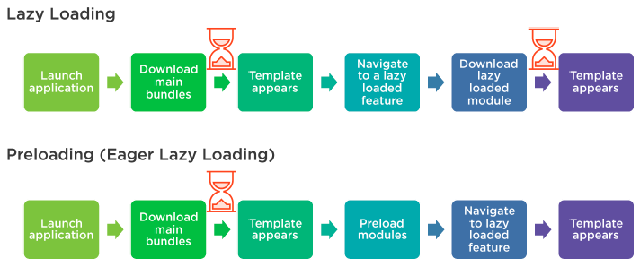
Lazy Loading
  Preloading Feature Modules

Slide 8
Summary

Slide 9
Assignment

Slide 10
Self Study
  Angular Routing
  https://app.pluralsight.com/library/courses/angular-routing

